Slide 1
CMP 1903M Assessment 1
By Joe, Olegs, Courtney, Ahad, Archie

Slide 2
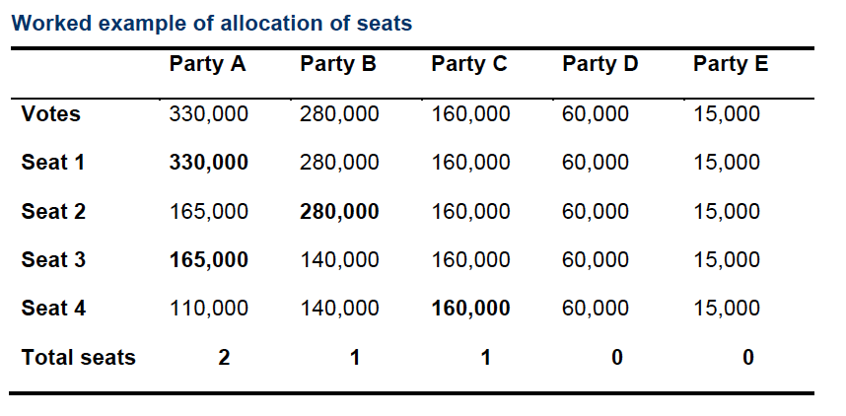
Introduction
The assignment task was to create a voting calculator specified to the D’Hondt method for proportional representation: OOP implementation and principles, version control.
The D’Hondt formula consists of finding the highest average value within a set, used concurrently within electoral systems around the world, minimising the disproportionality within many current voting systems, such as First Past The Post.
In this worked example, a fixed amount of 5 seats is being distributed between the 5 parties. Very similar to the context of the assignment using the European Parliamentary voting process as another example.

Slide 3
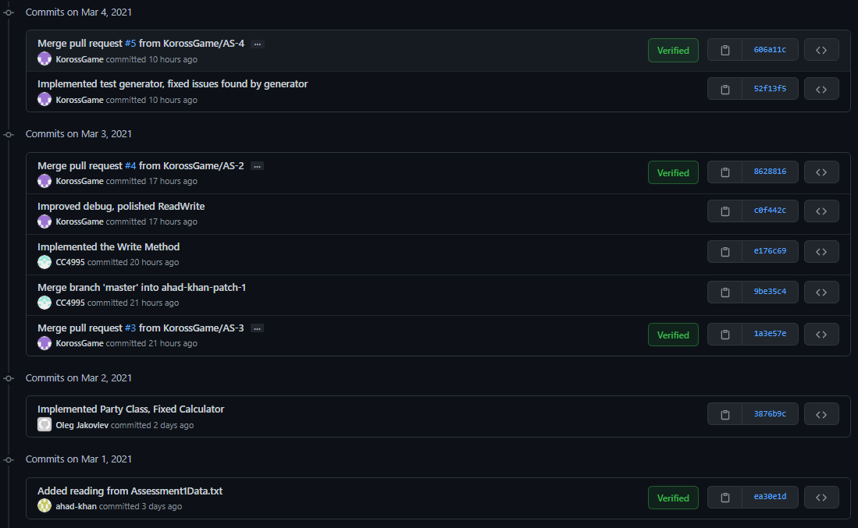
Version Control
Using Git and Github to manage versions of the projects was smooth and streamlined, it gave us room to test our implementations without the fear of the project crashing, making sure that debugging and stress testing was easy to handle.
Each update was accompanied by a series of patch notes / comments specifying the changes made. And using pull requests before moving any files to our master folder, ensuring a stable final build.
Repository may be found: https://github.com/KorossGame/election-soft

Slide 4
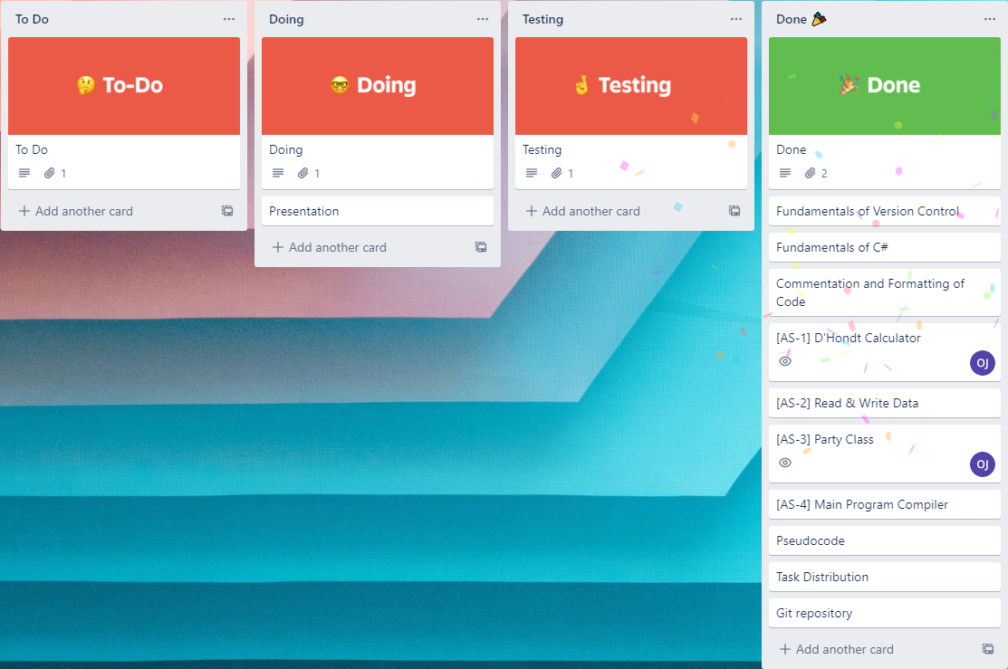

Team Collaboration
To help us keep on track with specific tasks and portions of the assignment, we created a team chat and a ticket tracker using Discord and Trello.
Splitting up the workload and getting help with problems that arose was very simple and manageable using these tools, and everyone was able to cooperate together as a well structured team.

Slide 5
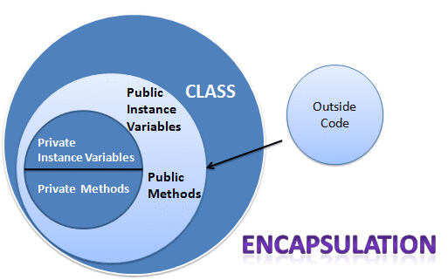
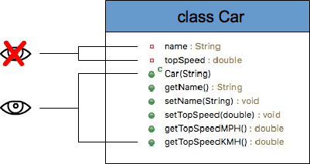
Encapsulation
Party object created in interdependent from any other system / object being used in our final build. Classes work together around the core object, for example using the data we received from the text file in our calculation as well as storing that data for other classes to read: i.e. (ReadAndWrite → Calculator) and the Party object.

Slide 6
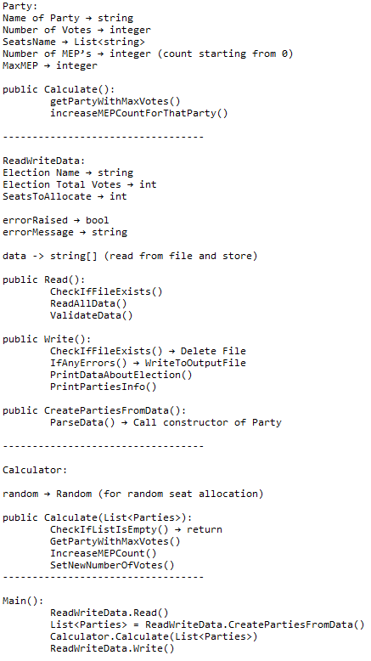
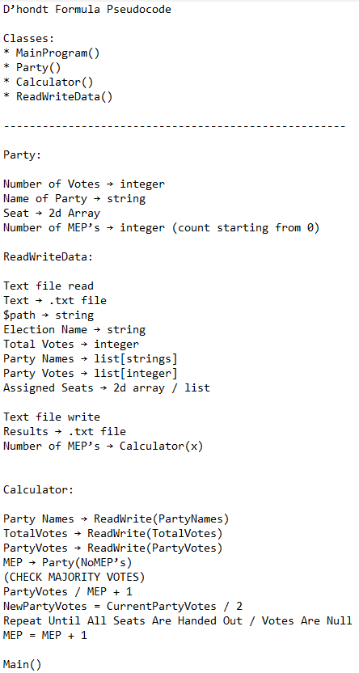
Abstraction
During the process of abstraction within our project, we began with a vague simplification of the problem, converting it into small tasks and potential classes.
As we began to flesh these classes out it became apparent that we could further abstract the problem and condense the information we had into a more concise direction.
Iterating on our findings we continued to abstract our pseudocode, making the implementation focused and capable of a better quality solution.

Slide 7
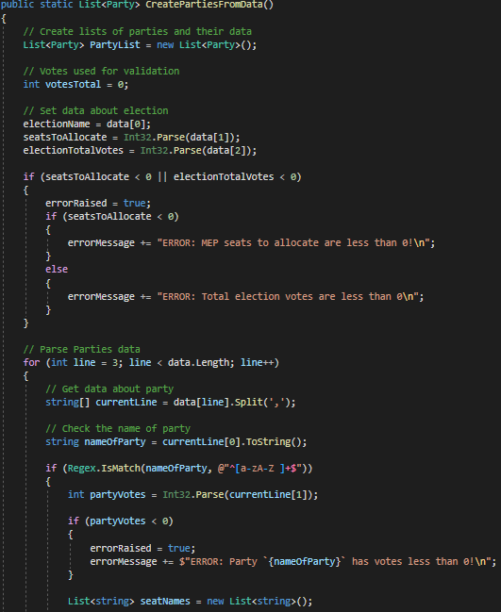
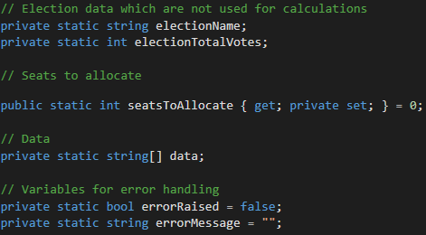
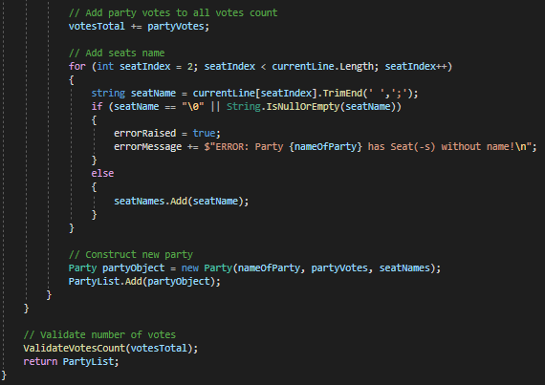
Implementation: ReadWrite Class

Slide 8
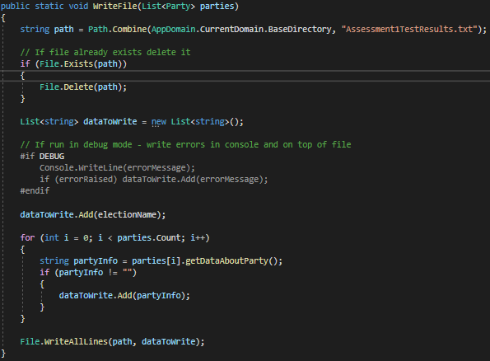
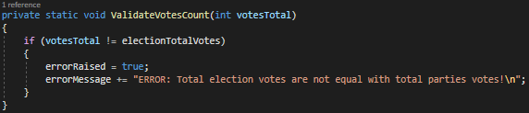
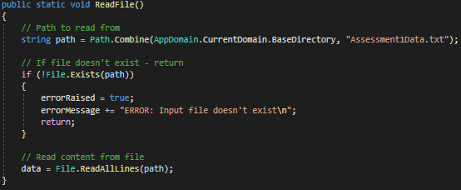
Implementation: ReadWrite Class

Slide 9
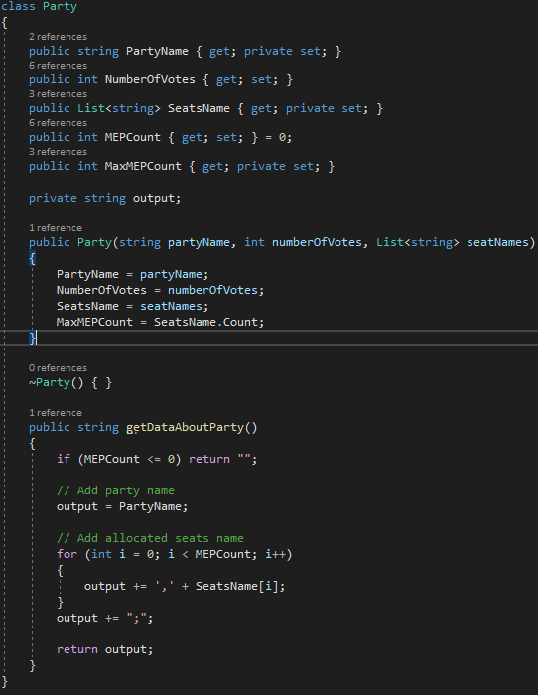
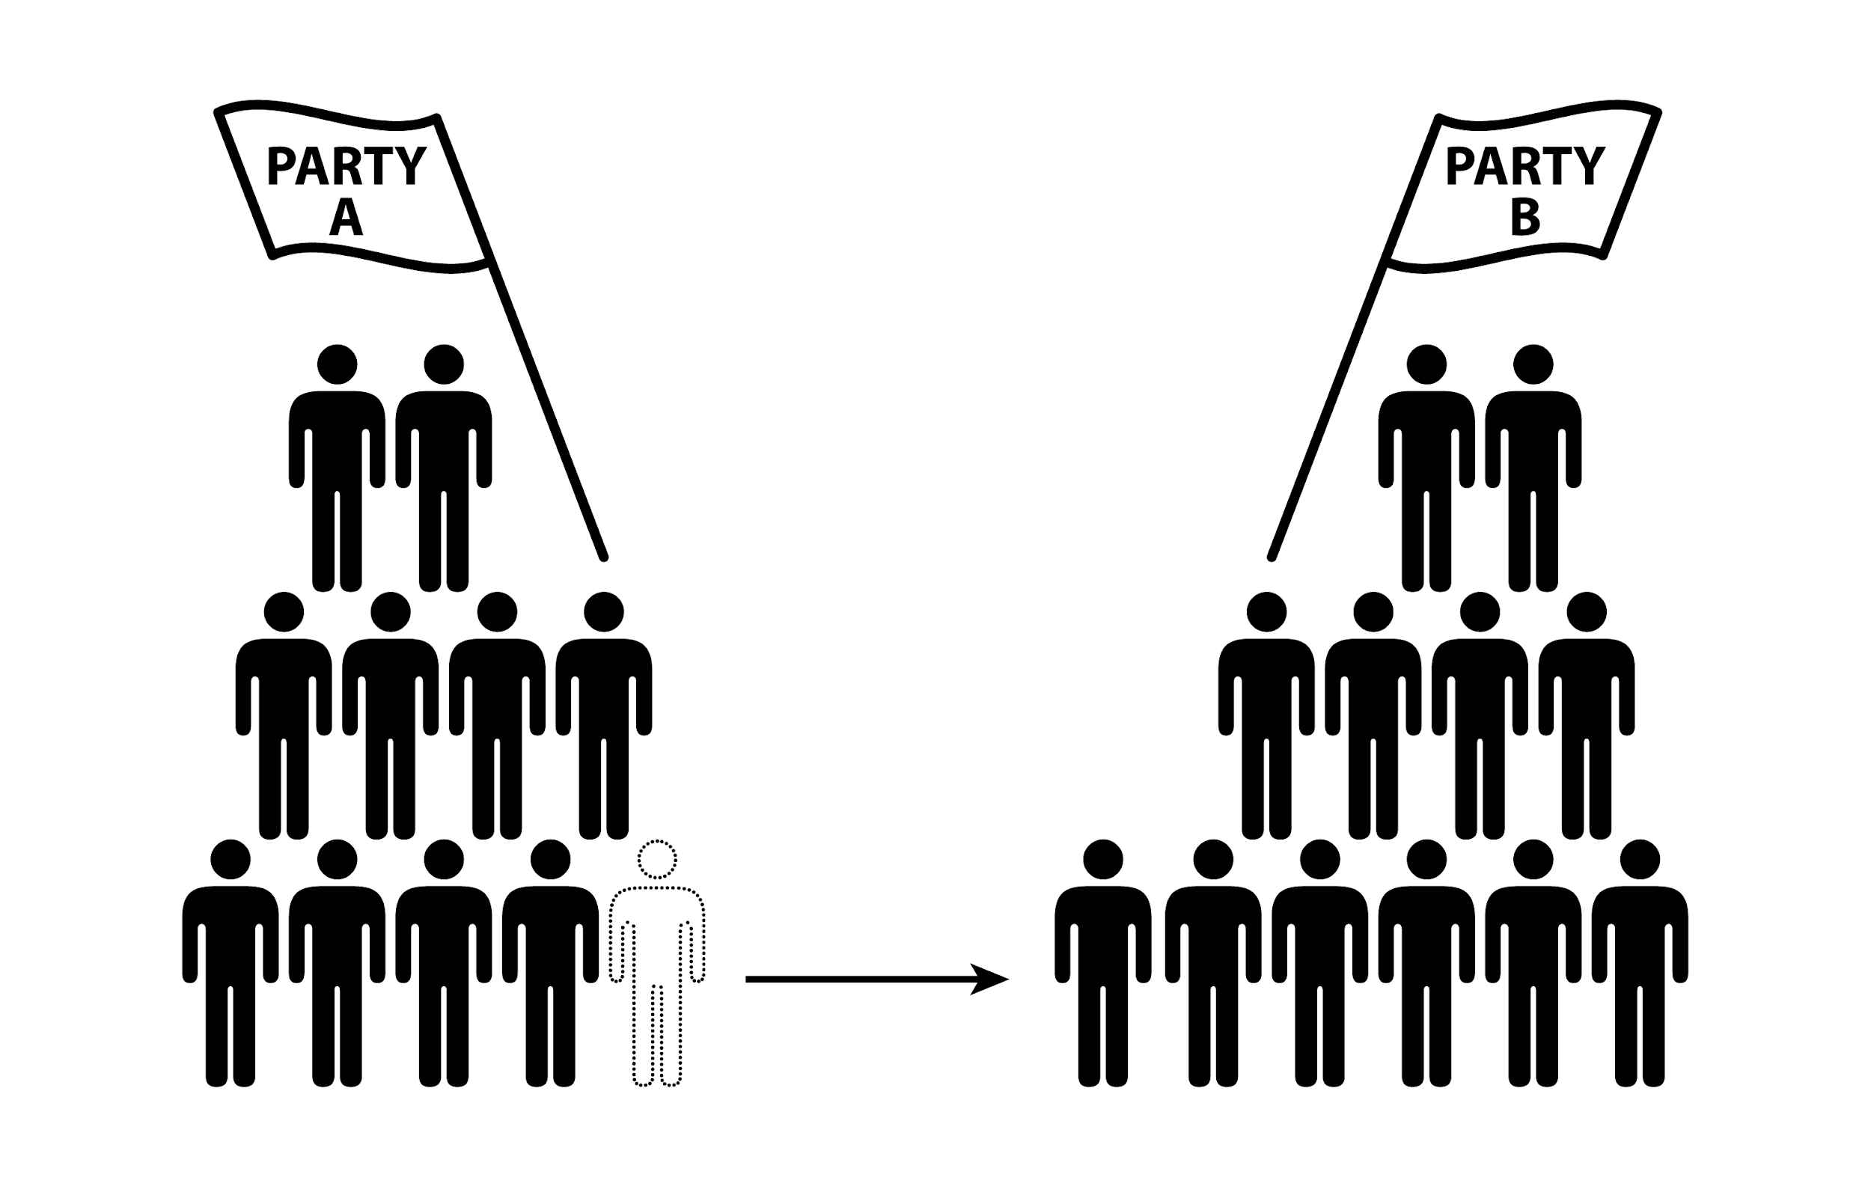
Implementation: Party Class

Slide 10
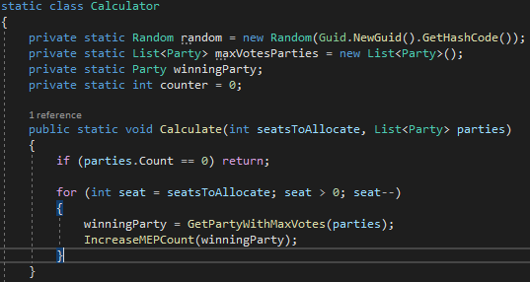
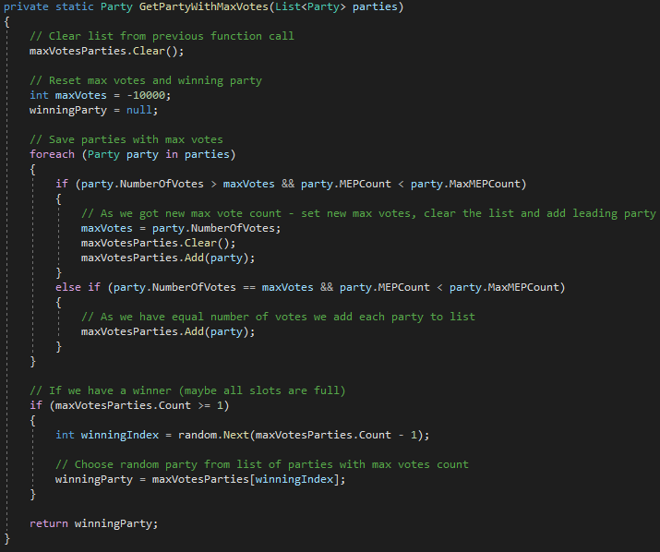
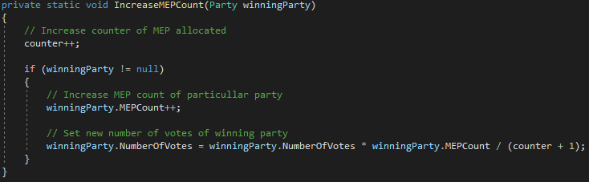
Implementation: Calculator Class

Slide 11
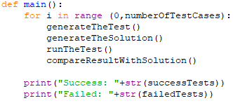


Stress Testing and Debugging
For testing we used random test data which allowed us to find various logical errors within our code, one of which was the event of a tied voting.
We used Python for its ease of use in handling files and our prior knowledge of the language, it has advantages over C# in that area as it requires no low level implementing.

Slide 12
References
Nick Hopkinson, Worked example of allocation of seats, image, https://www.london4europe.co.uk/european_parliament_elections [Accessed 4.03.2021]
Filip, 2017, Java encapsulation example, image, https://javatutorial.net/wp-content/uploads/2017/10/java-encapsulation.png [Accessed 4.03.2021]
Hansika Hans, 2018, Encapsulation in Java, image, https://www.linkedin.com/pulse/encapsulation-java-hansika-hans [Accessed 4.03.2021]
Venice Commission, 2014, Political parties, image, https://www.venice.coe.int/WebForms/pages/?p=02_parties [Accessed 4.03.2021]

Slide 13
Thanks for your attention and time

